Slide 1

Online Cab Booking System

Slide 2
INTRODUCTION:
Objective:
This Project aims to provide software to car booking services that maintain information about the customer details, vehicle details, driver details, booking details, and transaction details of the customer.
This System uses Java, Spring Boot application as Back End, and AngularJs as Front End to provide a flexible, easy-to-use environment.

Slide 3
MODULES & FUNCTIONALITIES:
Admin Modules:
Admin Profile
Customer List
Cab Approval
Booking List
Add Driver
Driver List

Slide 4
MODULES & FUNCTIONALITIES:
Customer Modules:
Cars
My Bookings
Customer Profile

Slide 5
TOOLS AND TECHNOLOGY:
TOOLS
Visual Studio Code
Spring Tool Suite
Postman
DATABASE
MySQL - v8.0
TECHNOLOGY
Front End
HTML and CSS
Angular JS – v14.2.3
JavaScript
Back End
JAVA - v11
Spring Boot – v2.7.4

Slide 6
PROJECT MEMBERS
FRONT END
Govardhan Sai Naga Teja Poola
Harinyvidhya Subbiah
Jayaraj C L
Johnsirani Senthilkumar
Kanulla Vidhya
Karthigashree Saravanan
Nirmala Selvaraji
BACK END
Govardhan Sai Naga Teja Poola
Harinyvidhya Subbiah
Jayaraj C L
Johnsirani Senthilkumar
Kanulla Vidhya
Karthigashree Saravanan
Nirmala Selvaraji
DOCUMENTATION
Johnsirani Senthilkumar
Nirmala Selvaraji
DATABASE
Jayaraj C L
Johnsirani Senthilkumar

Slide 7
MENTORS
Bharath P.
Supporting Mentor
Ankita Mithaiwala

Slide 8
DETAILED ANALYSIS - TIMELINE
1 May – 5 May | 8 May – 12 May | 15 May – 19 May | 22 May – 31 May
Overview of Project. Planned the project and recorded the technologies to be implemented. Distributed the tasks. | Started working on back-end. Collected data for the database. Completed creating the back-end for Cab Booking. | Started working on front-end web pages. Completed creating web pages for the Cab Booking. Successfully established the connection between front-end web pages and back-end. | Deployed the project into run-time environment with successful output. JUnit Test Design Documentation. Project Support Guide

Slide 9

HOME PAGE

Slide 10
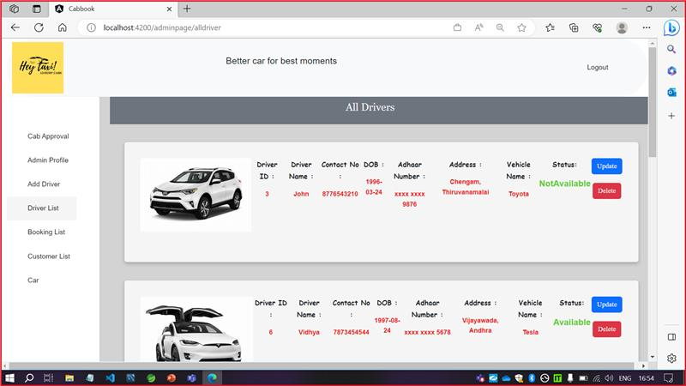
ADMIN HOME PAGE

Slide 11
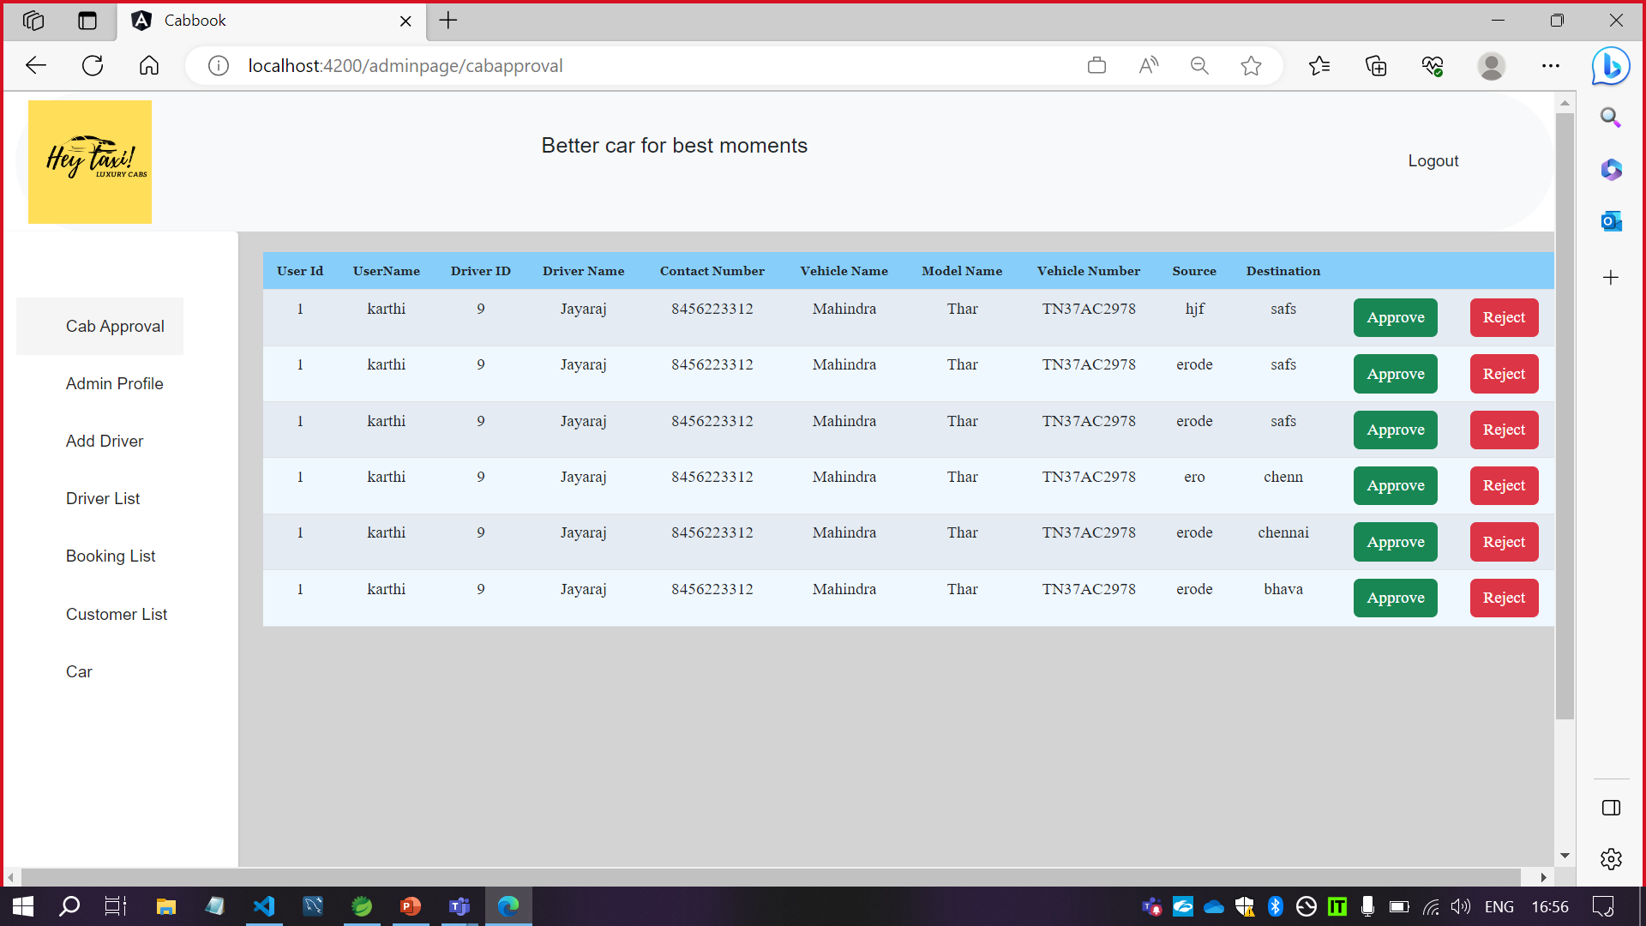
APPROVAL LIST

Slide 12
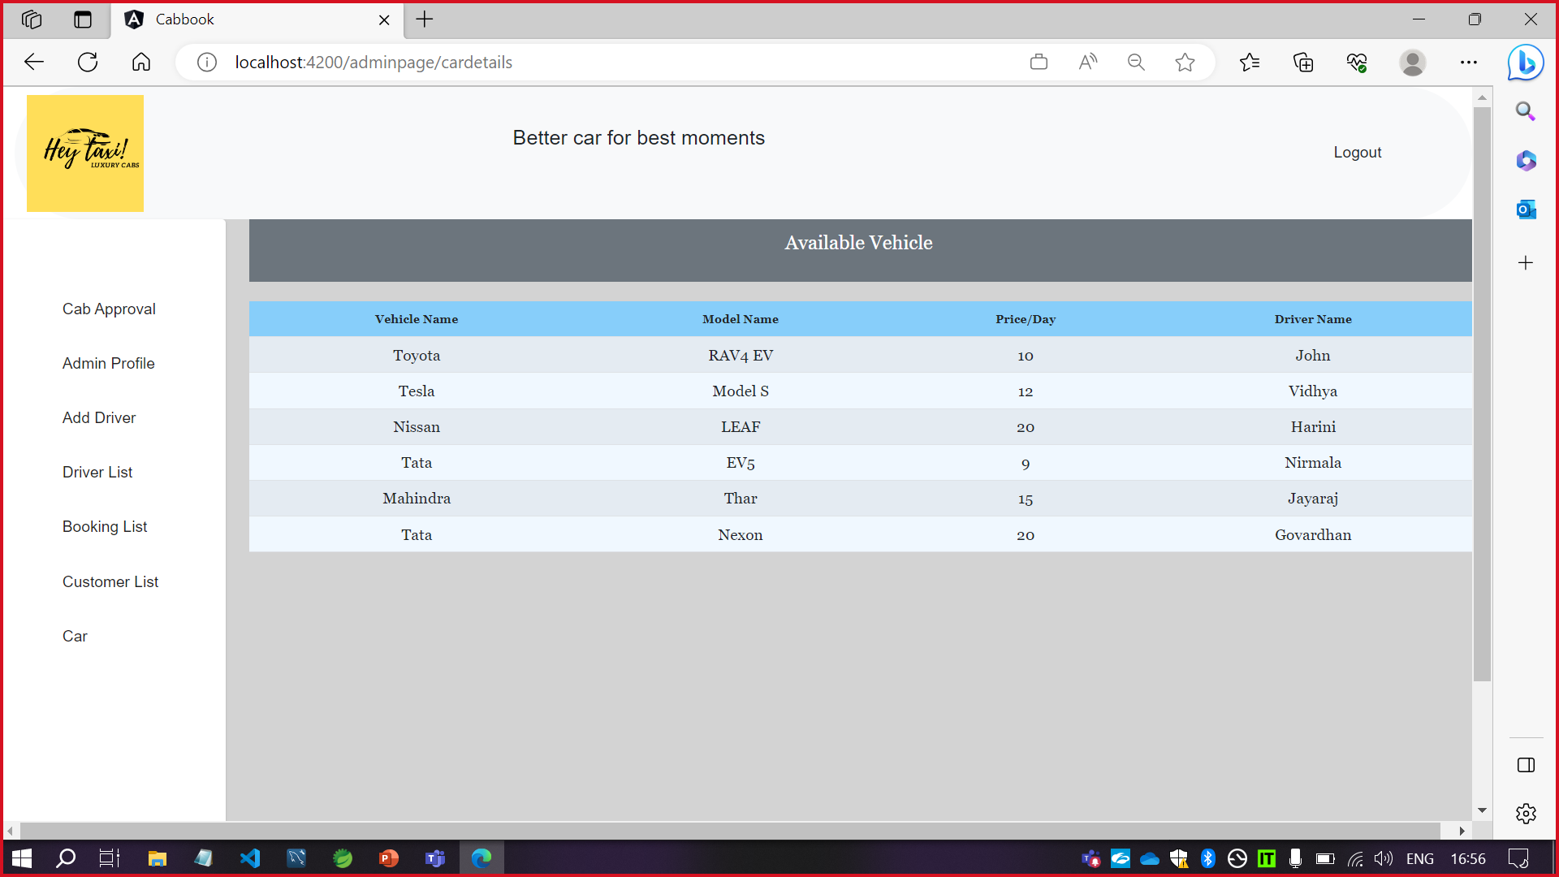
AVAILABLE VEHICLE LIST

Slide 13
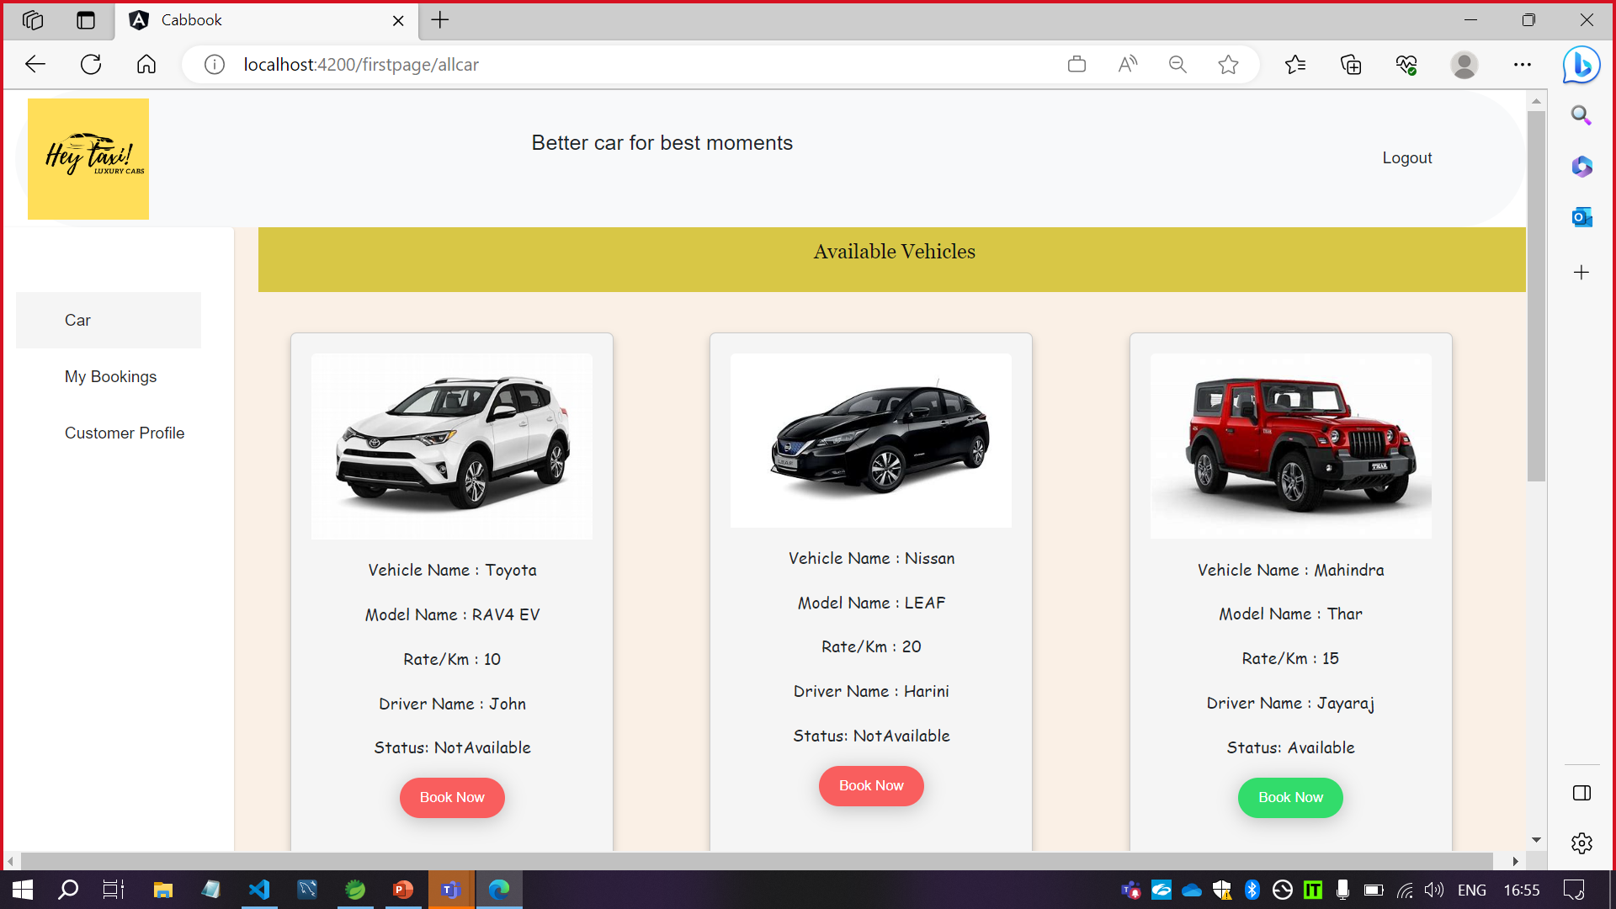
USER HOME PAGE

Slide 14
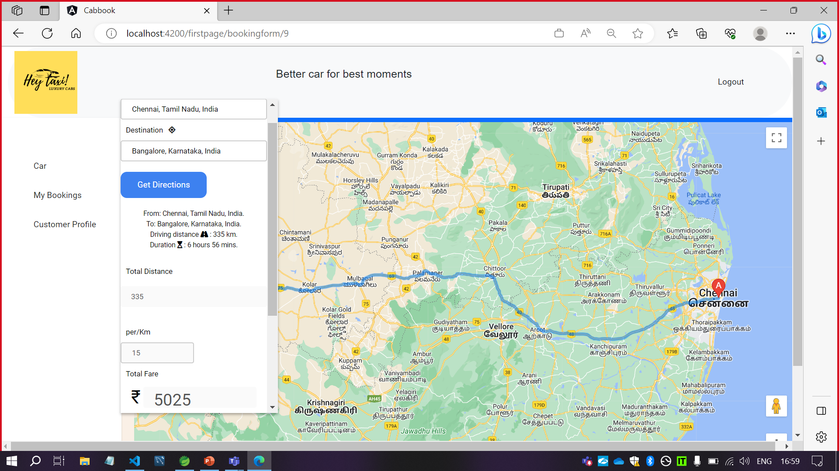
BOOKINGS PAGE

Slide 15
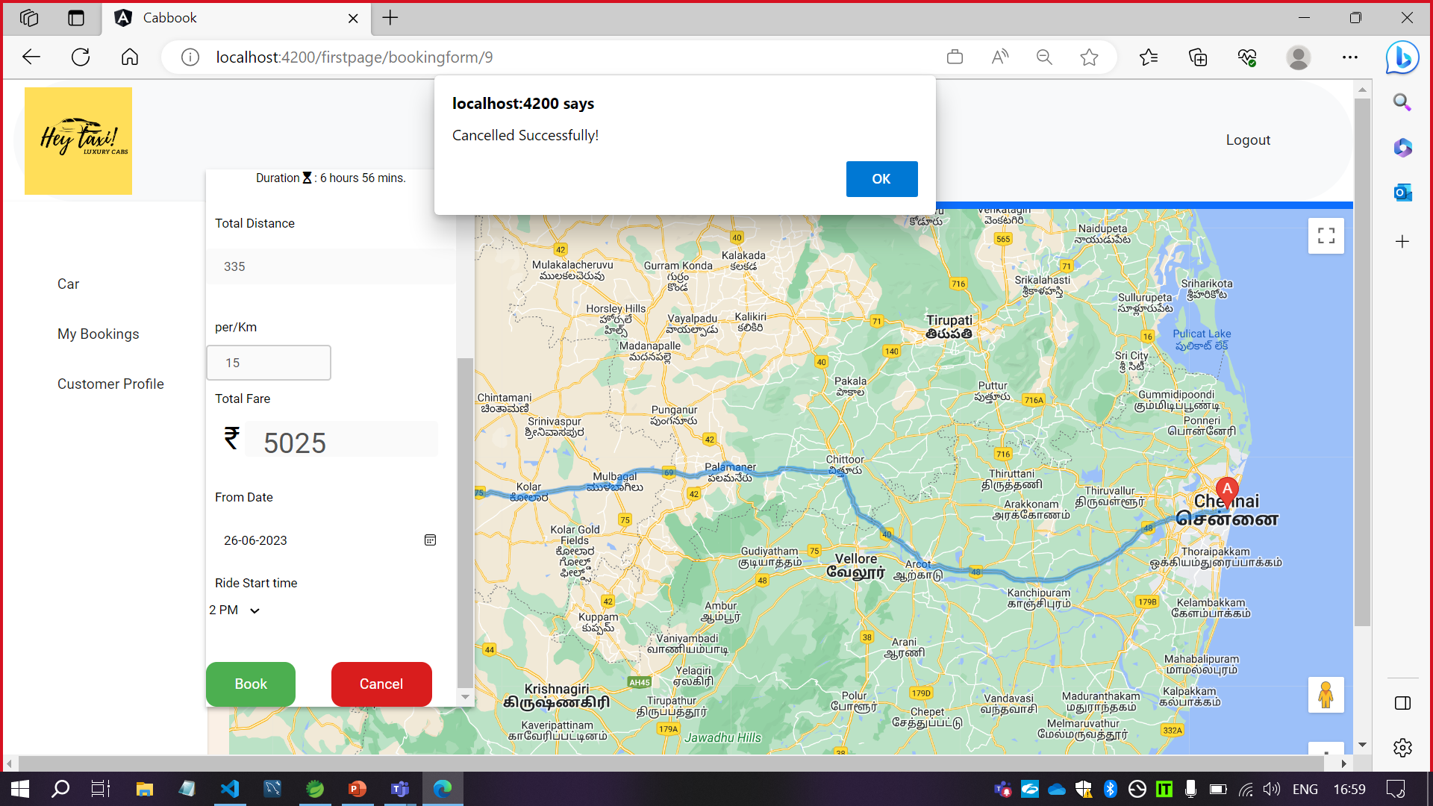
CANCELLATION

Slide 16
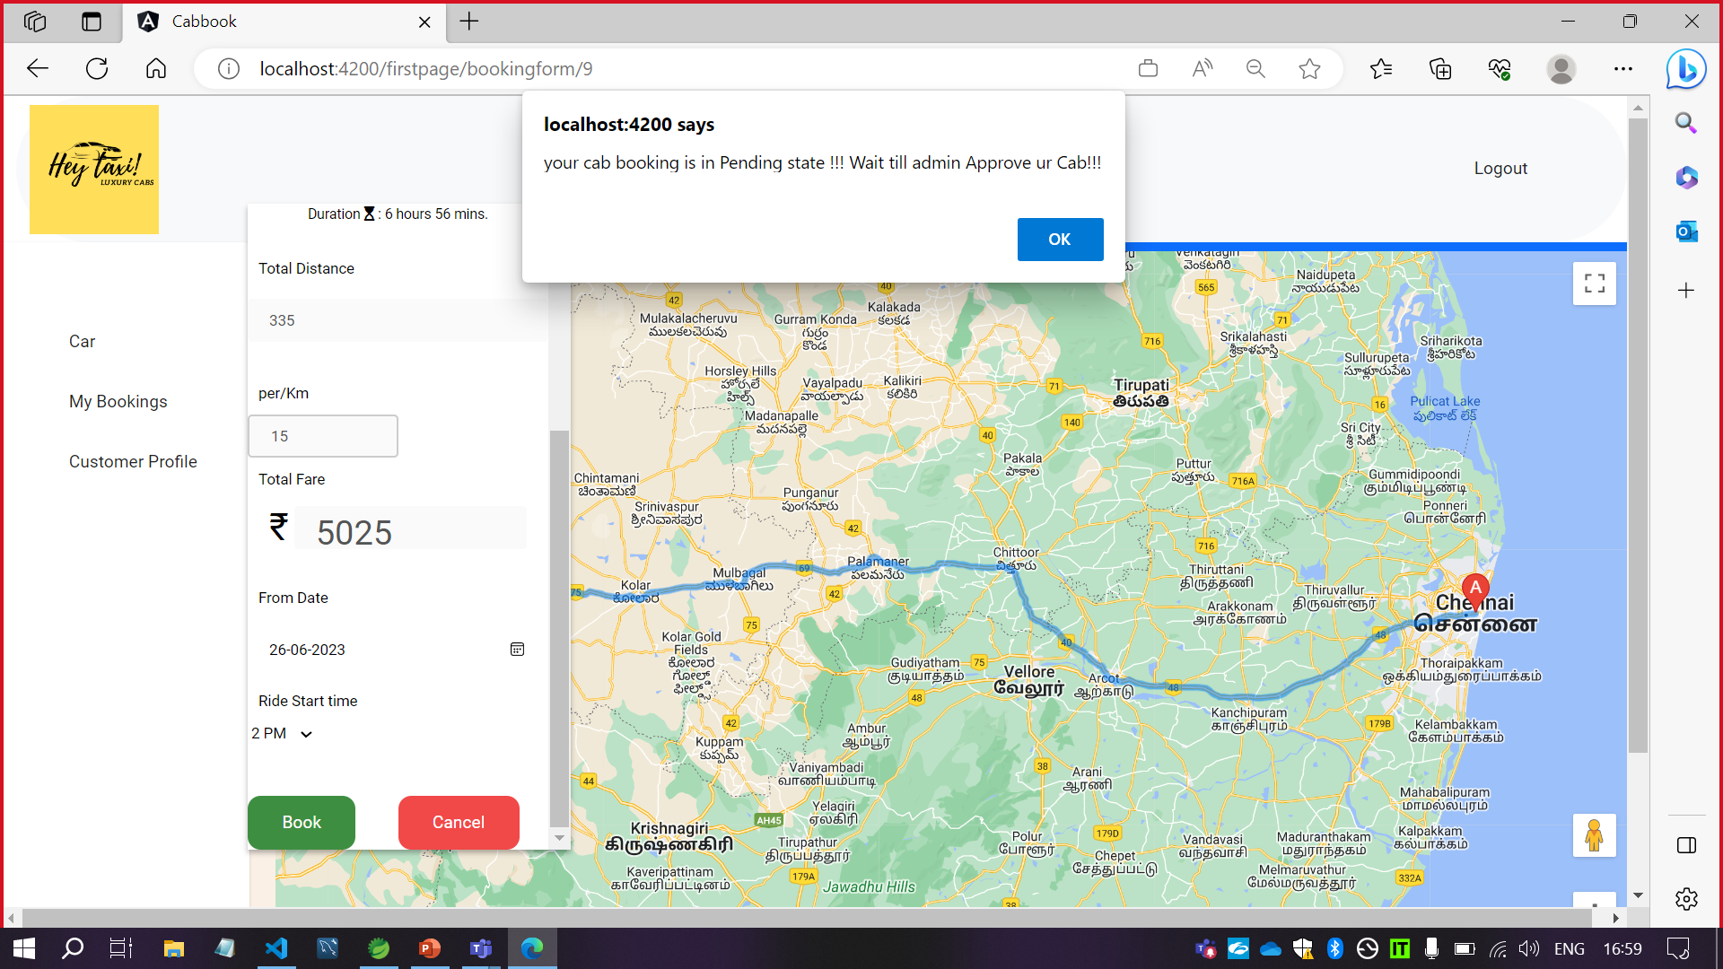
SUCCESSFUL BOOKING

Slide 17
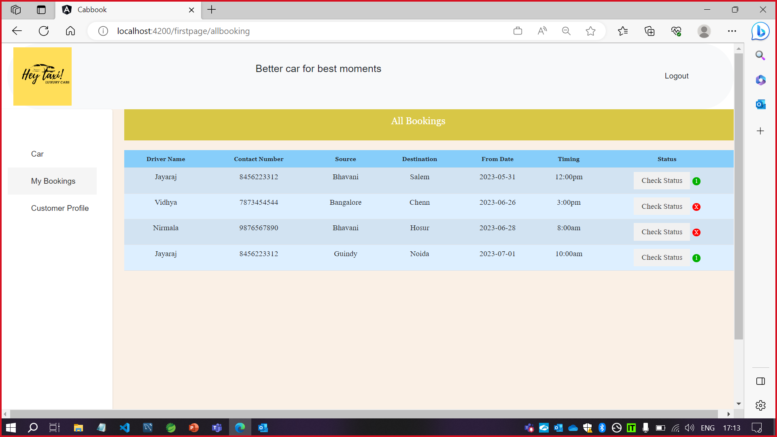
NOTIFICATION AFTER APPROVAL

Slide 18
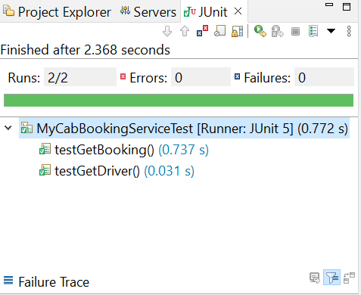
JUNIT TEST

Slide 19
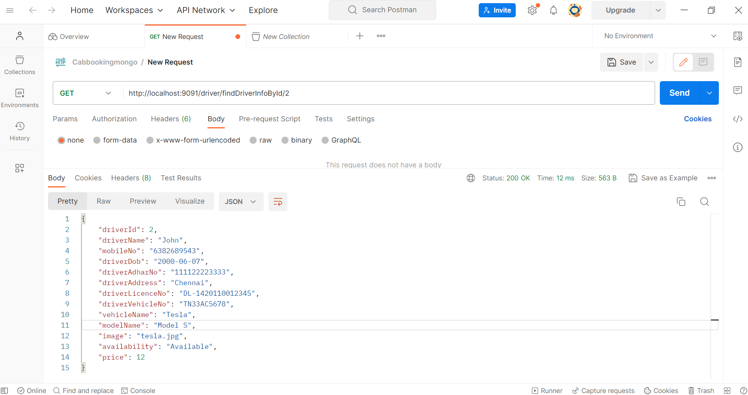
POSTMAN

Slide 20
DOCUMENTATION
Project PPT
JUnit Test Results
JUnit Test Report(after and before code fix)
Mini Project Documentation

Slide 21
DOCUMENTATION
Documentations uploaded to DXC Git under documents repository:
Online-Cab-Booking-System/Documents/

Slide 22
UPCOMING ENHANCEMEMT
Payment Gateway
Rating Module
Authentication
Spring Security

Slide 23
THINGS WE LEARNED
Technical discussions
Public speaking- Toastmaster sessions
Status updates
Connecting with team
Call meetings
Teamwork- Project development

Slide 24
THANK YOU

